Slide 1
Basic of atomic Theory introduction to particle physics standard model
Taha Khan
25F-CY-088

Slide 2
1. Basic of atomic theory
① Basic of Atomic Theory Definition Atomic theory explains that all matter is made of small particles called atoms, which consist of electrons, protons, and neutrons. Introduction Atoms are the fundamental building blocks of matter. An atom contains a tiny nucleus made of protons and neutrons, surrounded by electrons in different energy levels.

Slide 3
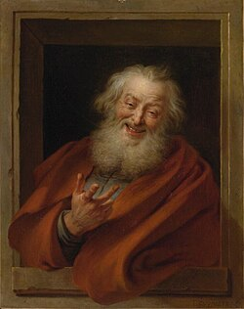
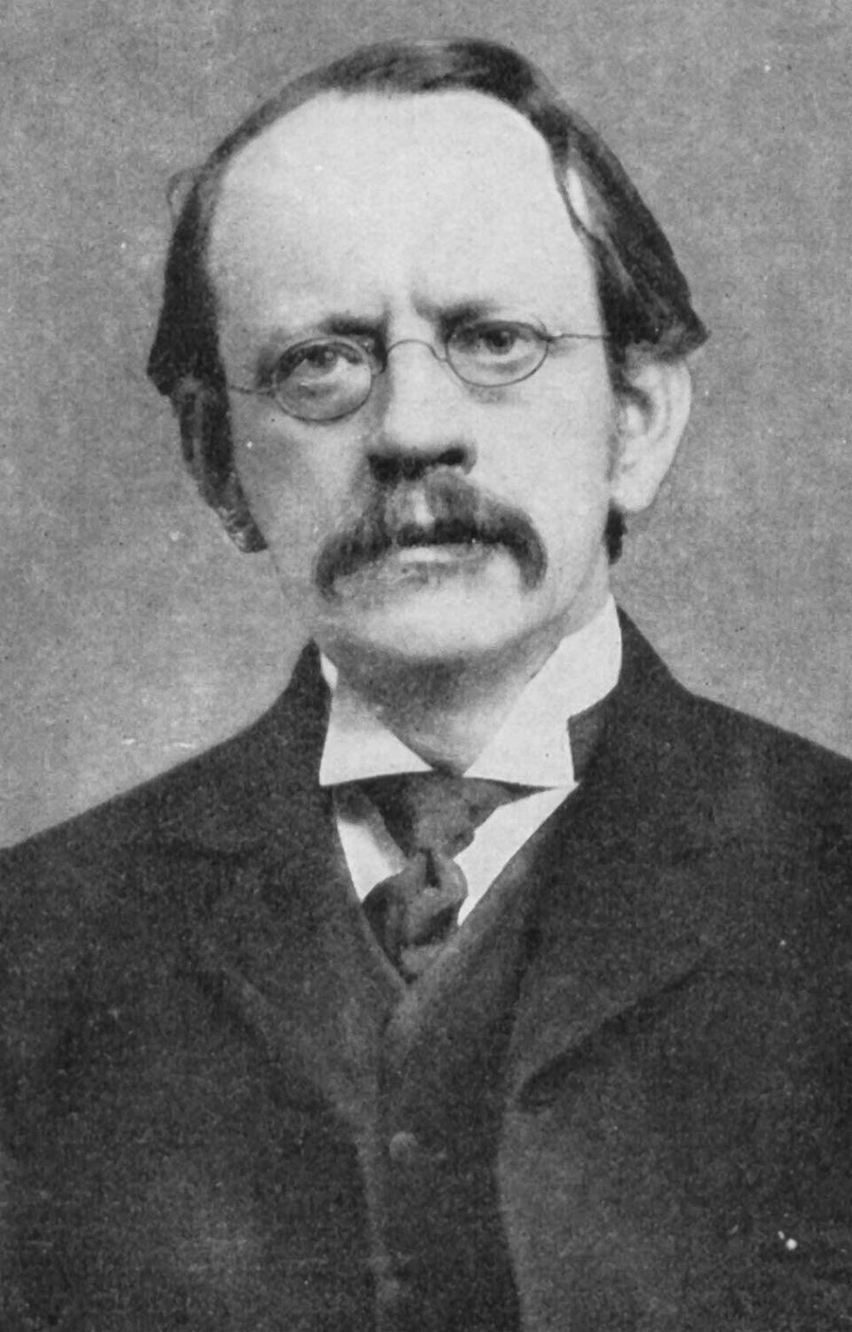
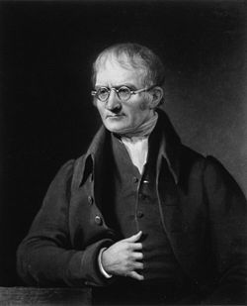

History of atomic theory
Democritus (400 BC) First concept of indivisible atoms
John Dalton (1803) Experimental atomic theory
J.J. Thomson (1897) Electron discovery, Plum pudding model
Bohr (1913) Electrons in fixed energy levels

Slide 4
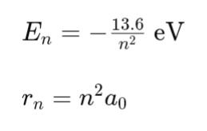
Mathematical formula and applications
Mathematical Formula (Bohr Model) Energy of electron in nth orbit:
Applications of Atomic Theory Explains chemical bonding and reactions Used in nuclear energy (fission & fusion) Foundation of periodic table Used in lasers, semiconductors, and electronics

Slide 5
Introduction to particle physics
Definition Particle physics studies the smallest known particles of the universe (quarks, leptons, neutrinos) and the forces acting between them.
Introduction While atomic theory explains atoms, particle physics goes deeper to explore particles inside protons and neutrons. It studies high-energy interactions using particle accelerators like CERN. It aims to understand how the universe began and what it is made of.

Slide 6
History
1930s Discovery of neutron & beginning of nuclear physics
1960s Quark model proposed by Gell-Mann & Zweig
1970s–1980s Development of Standard Model
2012 Higgs Boson discovered at CERN

Slide 7
Mathematical formula and applications
Formula
E=mc²
Applications of Particle Physics Creation of medical technologies (PET, MRI, radiation therapy) Development of semiconductors & nanotechnology Understanding cosmic rays and Big Bang Nuclear reactors & particle accelerators

Slide 8
Standard model
Definition The Standard Model is a scientific theory that classifies all fundamental particles and three forces of nature (strong, weak, and electromagnetic, excluding gravity). Introduction The Standard Model explains how matter is built from quarks and leptons, and how forces act through bosons. It is the most accepted theory in modern physics, successfully predicting the Higgs Boson in 2012.

Slide 9
History
1960s Unification of weak and electromagnetic force 1970s Quark model + particle classification 2000s Model experimentally verified 2012 Higgs Boson discovered (CERN)

Slide 10
Applications of standard model
Applications of Standard Model
Explains formation of matter and energy Used in cosmology & dark matter study Development of particle accelerators Basis for quantum field theory Used in advanced medical radiation technology

